Slide 1
Stanford BPSM PM Toolbox Workshop
19.01.25
Mustafa Al Ibrahim
https://goo.gl/AJTE8E or https://github.com/MosGeo/PMToolbox

Slide 2
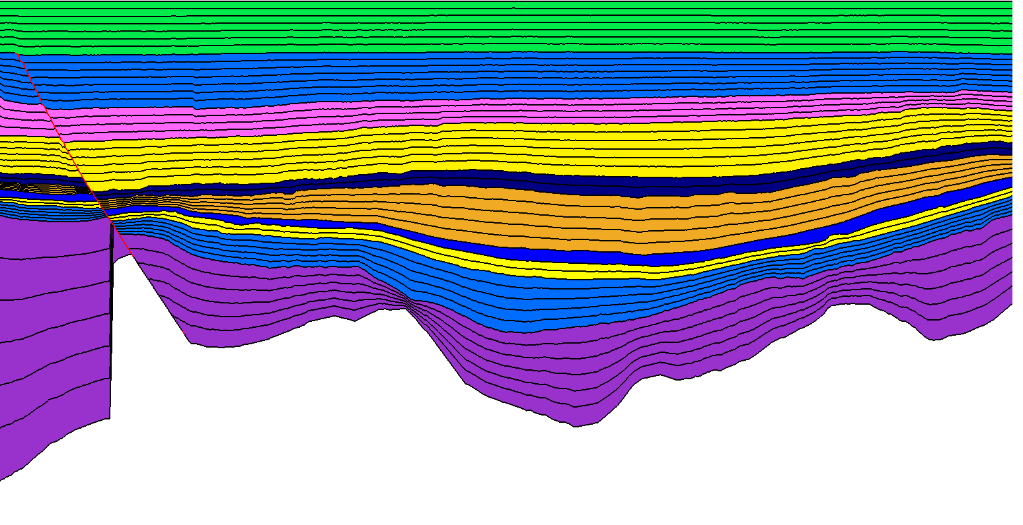
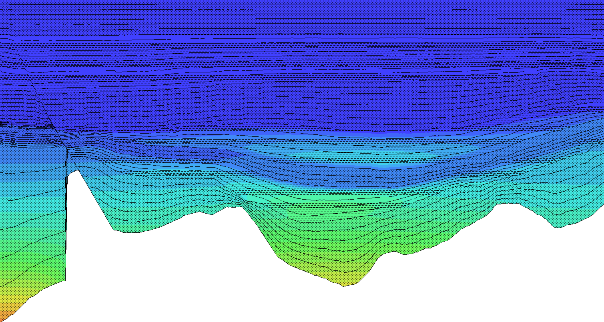
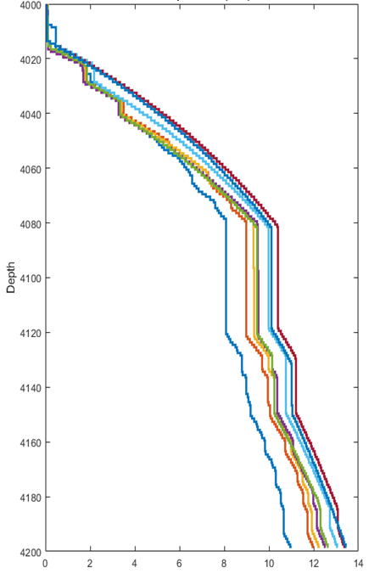
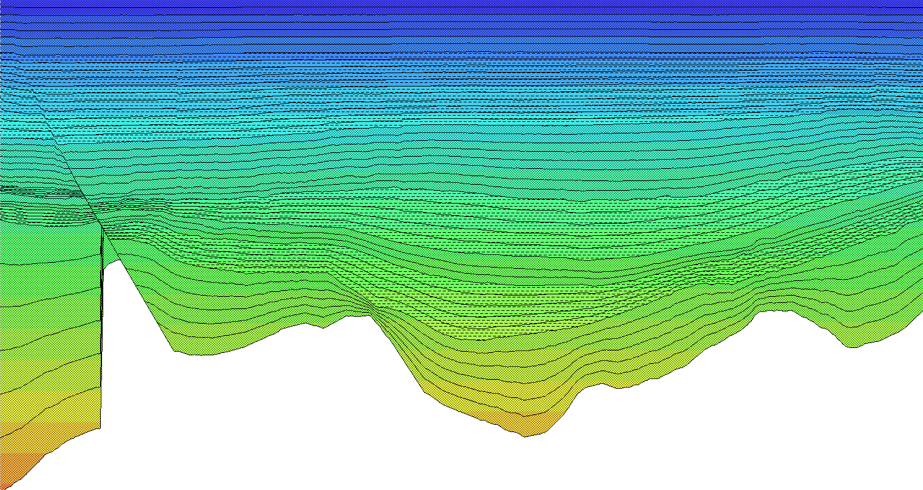
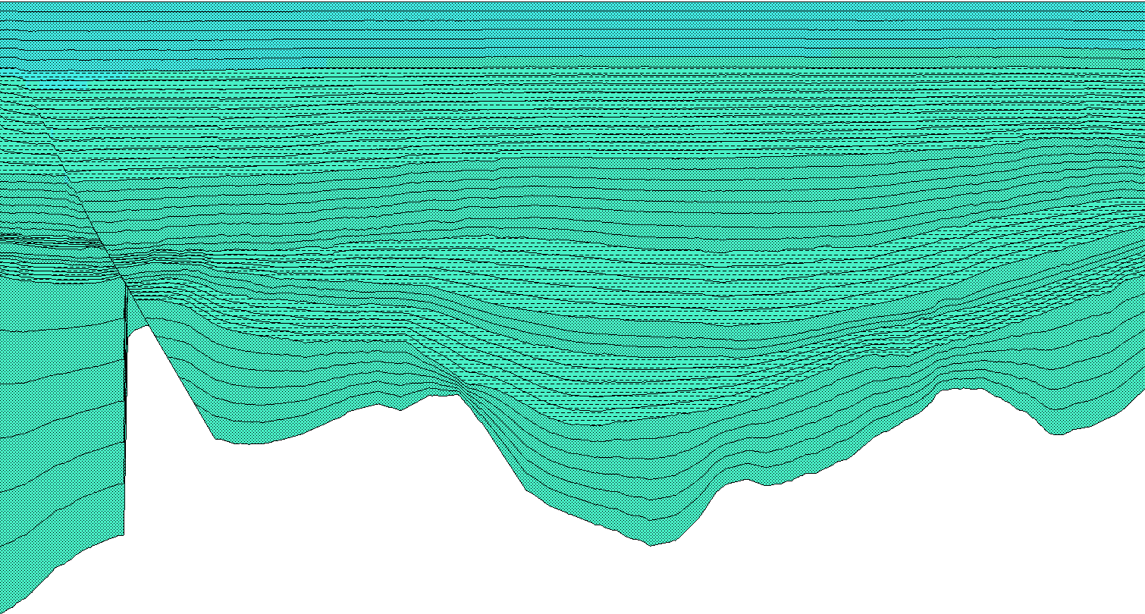
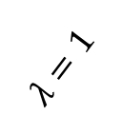
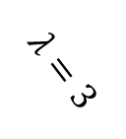

Goal: Automate the PetroMod workflow for creating and running multiple “similar” models
New models
Output overlay
Sim
Accumulate results from different models
$$λ=1$$
Post-process
Template model
$$λ=2$$
Sim
Post-process
$$λ=3$$
Post-process
Sim
Slides and code
https://goo.gl/AJTE8E

Slide 3
Philosophy: Prefer generalization of code over ease of use
Not a substitute for the complete graphical user interface: create your template model in the graphical user interface
The code is not safe
Little error checking is done.
The code allows you to input any parameter values (e.g., negative porosity).
You can modify things that you shouldn’t (e.g., default lithologies).

Slide 4
Current capabilities
Duplicate and update lithologies
Duplicate and update models (1D, 2D, 3D*)
Simulate models
Load results in Matlab (present day results only)
Why not more (e.g., kinetics editor)?
Features are added as needed by the current research
*I have not tested 3D models extensively

Slide 5
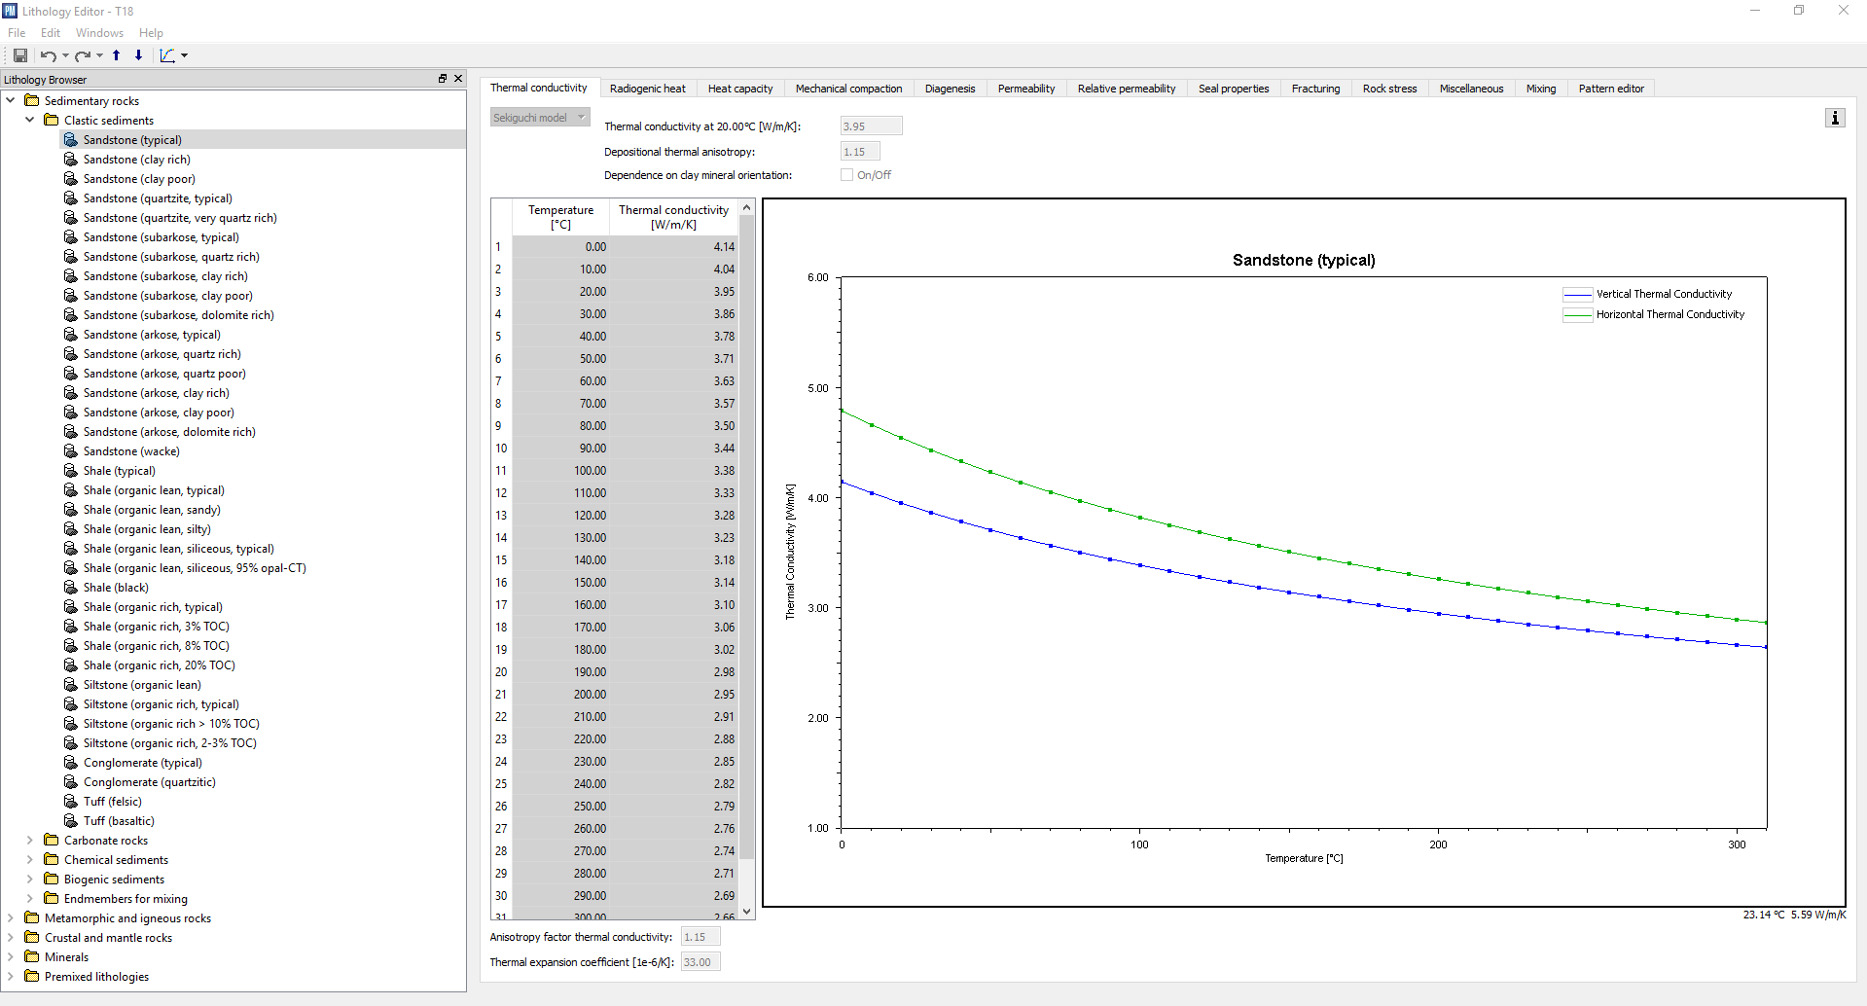
Lithology capabilities: replicate all functionalities of lithology editor
Duplicate lithologies
Change values including scalers and curves
Mix lithologies*
*Run some tests by mixing lithologies manually to make sure the desired results are obtained when mixing very different
lithologies, e.g., a rock with a mineral.

Slide 6
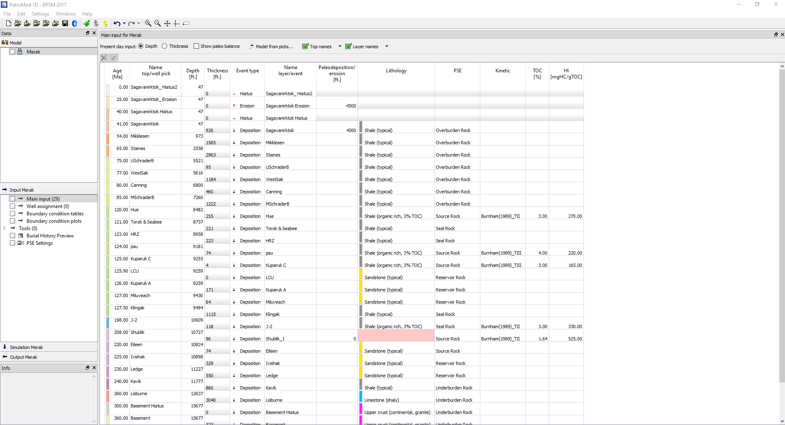
1D Model capabilities: replicate all functionalities of the 1D editor
Duplicate models
Change values in main input
Change boundary conditions (PWD, SWIT, HF)
Change simulation settings

Slide 7
2D and 3D Model capabilities: replicate most functionalities of the 2D and 3D editors and simulators
Duplicate models
Update SWIT, HF, PWD boundary conditions, including simple trends and maps
Update fault properties
Update facies
Update simulation parameters
Update horizon depth

Slide 8

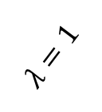
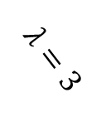

Suggested workflow: do each strip separately*
Build template model using the GUI
Sample the parameters
1. Update lithologies
2. Create models
Simulate
Load the data from results
Use the results
1
2
New models
Use parfor
Output overlay
Sim
e.g., accumulate results from different models
$$λ=1$$
Post-process
Template model
$$λ=2$$
Sim
Post-process
$$λ=3$$
Post-process
Sim
*There are instances where this will not work, e.g., if the update in the second model depends on the first model

Slide 9
Tips
Make sure to modify the parameter that you want to change using the GUI in the template model, e.g., if you want to modify paleo water level in a 2D model, insert a template paleo water level in the template model. This would expose it to the toolbox.
Run some tests by comparing manually built models results with the Matlab built models results
Do not run simulation in the template model (or at least delete the results after running). This will make it faster when duplicating models.
Be careful with units when modifying values. Sometimes, the units are different compared to what it is displayed in the graphical user interface.
Be careful when mixing different lithologies. Check the results and make sure they match the mixture that is done manually.
If you can’t identify the location of a parameter, insert a “crazy” value in it to quickly identify it or test two different values and see what changes.

Slide 10

Access to the latest version (private repositories, contact me to get access)
https://github.com/MosGeo/PMToolbox
Other useful BPSM functions
https://github.com/MosGeo/BPSMToolbox

Slide 11
For developers
Language: Matlab (Can be ported to other languages)
Paradigm: a mix of dynamic and static classes (+ functional programming) ➔ hide complexities from the user.
Tips:
Generalized code: PM version agnostic
Maintain compatibility with over PM toolbox versions

Slide 12
PetroMod Class
Main class to control PetroMod:
Run simulations
Run open simulator scripts
Load/update lithology
Running simulation just calls the solver executable ➔ can easily write a script to simulate multiple models on the Linux cluster (even if patch mode is not available)

Slide 13
LithologyFile Class
XML file (>50,000 lines)
Three different components:
Meta: contains information about the names of the properties
Curve: contains any curve data (x,y)
Lithology: Contains lithologies values
Each lithology property needs to be connected to Meta to know the property name; each lithology curve values needs to be connected to curve
Use of hash codes and unique ID integers is important, i.e., cannot just copy lithology branch and rename it and everything will work. It has to have its own unique ID.
Dirtiest part of the current code.

Slide 14
Models Classes
3 classes: Model1D, Model2D, Model3D all inherit from a parent class Model.
These 3 classes contain information about the expected files to read stored in hashmap: tables($givenName$) = {$relativePath$, $fileType$}
tables('SWIT Table') = {'in/swim', 'pmt’};
Three general type of files used + 1 unused
PMT: an ascii based table with headers. Use PMTTools class to read and write.
PMA: an ascii based file. Can be variable in format (be careful). Simulation input uses this file.
PMD: a binary file. Use PDMTools class to read and write.
PMB: a binary file (still not decoded ☹ )
PMD Group: A PMT file that connects to multiple PMD files. Usually it is used to store maps/vectors data such as horizons, SWIT vectors wrt. time…

